Slide 1
Real-time Custom Object Detection Using YOLO
Ahmed Mostafa - Hossam Ahmed - Eslam Taha

Slide 2

What is YOLO?
You only look once (YOLO) is a state-of-the-art, real-time object detection system.
This is an algorithm that detects and recognizes various objects in a picture (in real-time).
The YOLO algorithm consists of various variants. Some of the common ones include tiny YOLO and YOLOv3.

Slide 3
YOLO Details

Slide 4
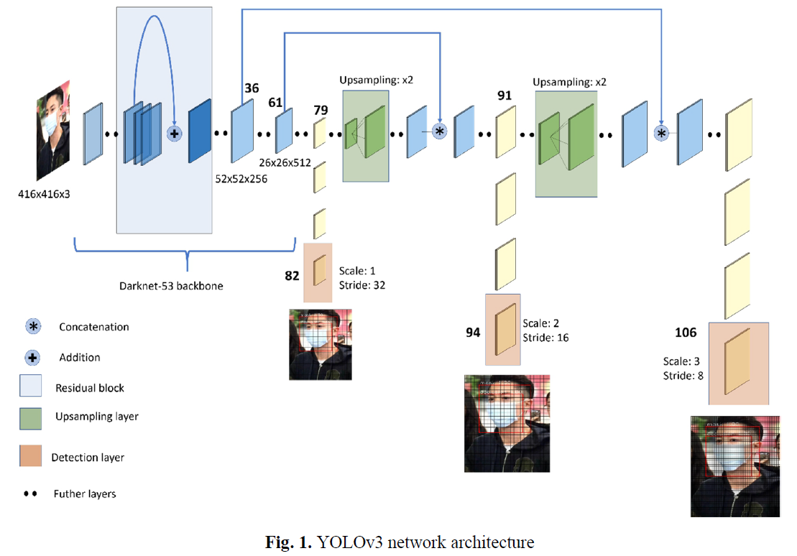
DarkNet-53
YOLO algorithm employs convolutional neural networks (CNN) to detect objects in real-time.
The feature extractor of the YOL0v3 contains 53 convolutional layers, and thus it is named Darknet-53.
The full YOLOv3 consists of 106 layers, including convolutional, residual, and up-sampling layers.
Trainable parameters = 65, 252, 682

Slide 5
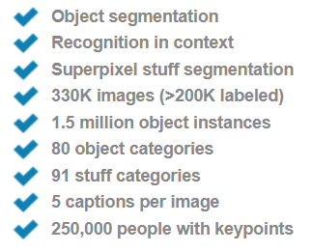
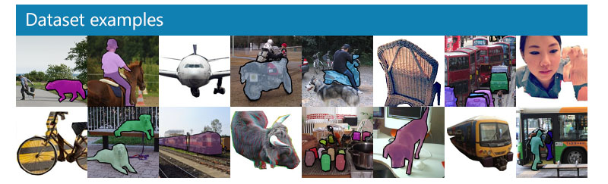
COCO DATASET
COCO is a large-scale object detection, segmentation, and captioning dataset.

Slide 6
Why YOLO?

Slide 7

Speed
As the name suggests, the algorithm requires only a single forward propagation through a neural network to detect objects.
This means that prediction in the entire image is done in a single algorithm run. The CNN is used to predict various class probabilities and bounding boxes simultaneously.

Slide 8

Accuracy
YOLO is a predictive technique that provides accurate results with minimal background errors.

Slide 9
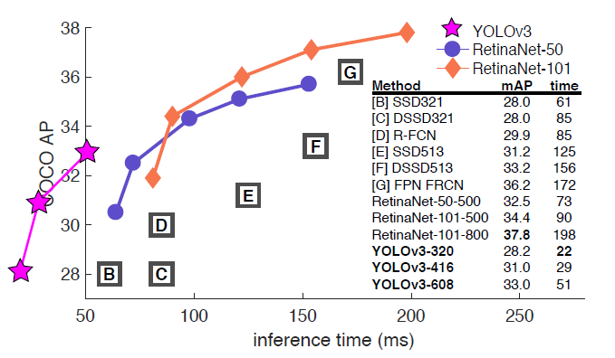
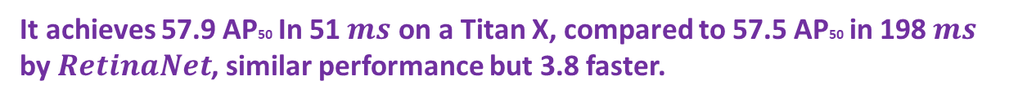
Times from either an M40 or Titan X, they are basically the same GPU
It achieves 57.9 AP50 In 51 $ms$ on a Titan X, compared to 57.5 AP50 in 198$ms$ by $RetinaNet$, similar performance but 3.8 faster.

Slide 10
How YOLO works?

Slide 11
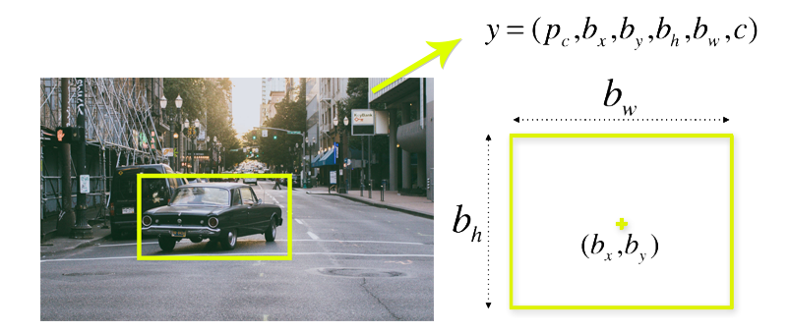

Slide 12
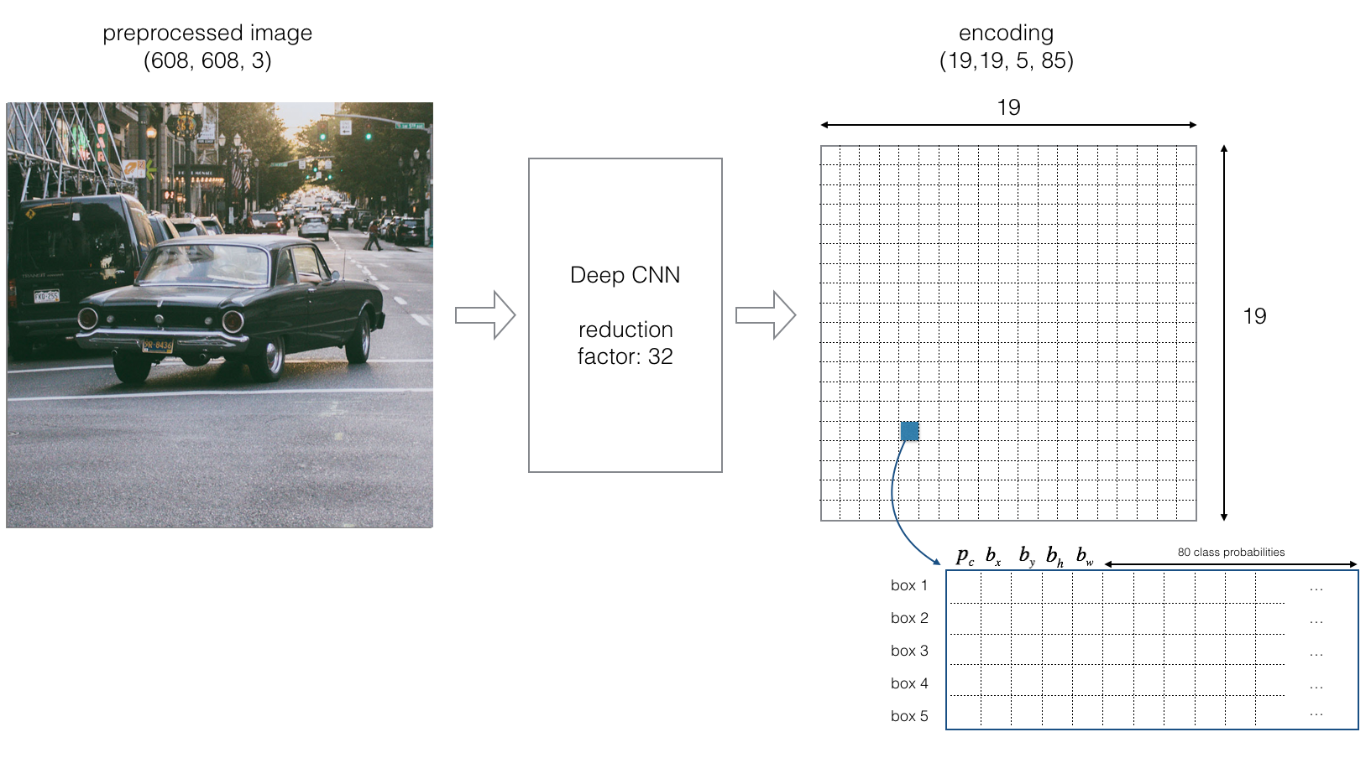
Regions

Slide 13
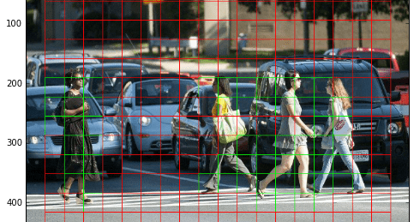

Slide 14
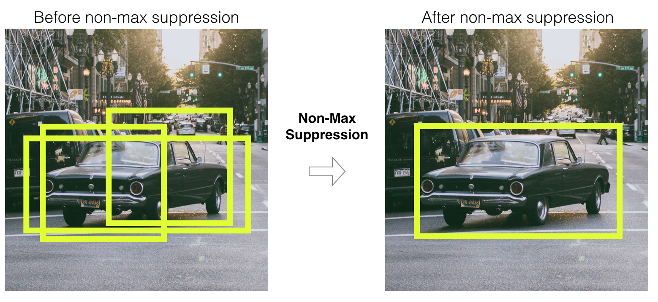
Detect, remove, suppress

Slide 15
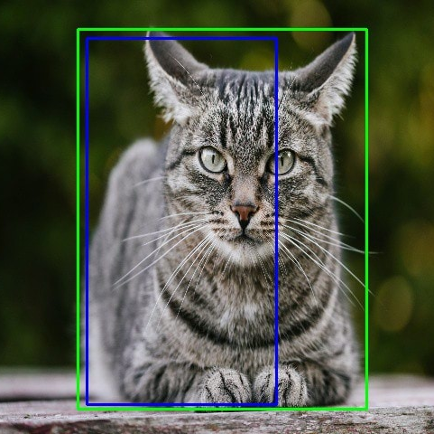
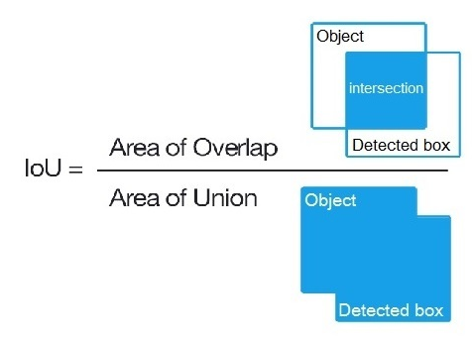
Intersection over union (IOU)
In the image above, there are two bounding boxes, one in green and the other one in blue.
The blue box is the predicted box while the green box is the real box.
YOLO ensures that the two bounding boxes are equal.

Slide 16
